Slide 1
Jobspot Application
Supervised By : DR / Hanan Fahmy

Slide 2






Meet Our Team
Mohamed Sobhy
Aya Ahmed
Mohamed Hamed
Moataz Ahmed
Naira Galal
Mohanad Darwish

Slide 3
TABLE OF CONTENTS
01
02
The Problem & Solution
Introduction
Job Seeker
& Company
Scenario
Related Work
&SWOT
03
04
Future Work
05
06
Tools & Technology
07
Questions?

Slide 4
Introduction 01

Slide 5
Intoduction
our application works on all versions of mobile android & ios for helping people(jobseekers) to make finding jobs more easily & convenient using smart phone
and connect with company and provides
an easy way to track their application.
We have 3 users in the application
Admin , jobseeker ,company

Slide 6
What is The Objectives
1-Language: Use English as the main language in the application to help different people to use the application easlliy.
2-Apply for a Specific Job: this applications allow job seekers to apply for specific job openings (matched jobs) based on his job_title.
3- Present Qualifications and Experience: jobseeker can add his information such as cv,skills&jobtitle.
4- Manage Application Workflow: Job applications help company in organizing and managing the application workflow for jobseekers

Slide 7
The Problem & Solution 02

Slide 8



THE PROBLEM (Job Seeker)
Unemployment
Time
Effort
Job Seeker find suitable job for him
It does not take up as much time as the manual methods
Follow the applicant and manage and conduct the interview afterwards

Slide 9


THE PROBLEM (Company)
Time
Effort
Companies can efficiently review applications and evaluate candidates based on predetermined criteria, saving time compared to manually assessing individual resumes or CVs
Save effort by you don’t need to hire employers to screening the CVs and filter them easily from app

Slide 10
Job Seeker & Company Scenario 03

Slide 11
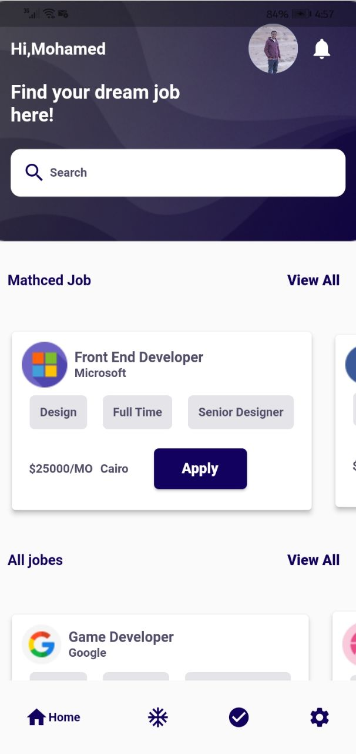



“Job Seeker
Scenario”
Matched Job
All jobs
Click on Apply

Slide 12
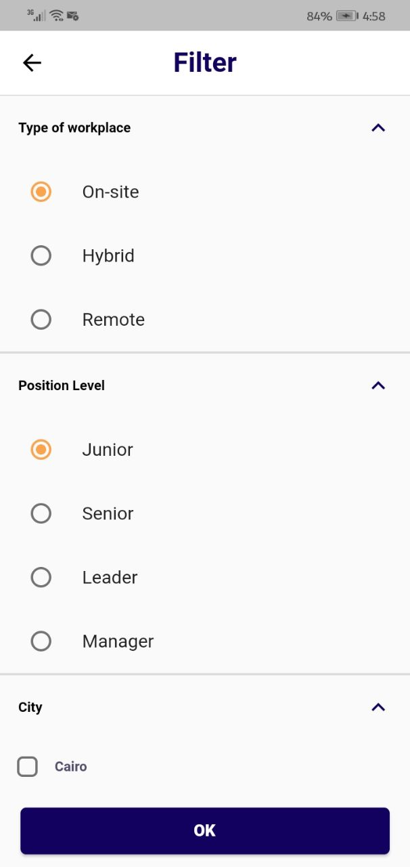

“Job Seeker
Scenario”
Search for a job with job_title and
Filter based on job_tybe , Level ,city

Slide 13


“Job Seeker
Scenario”
Enter Feedback and the
Admin will receive it
Edit Profile

Slide 14
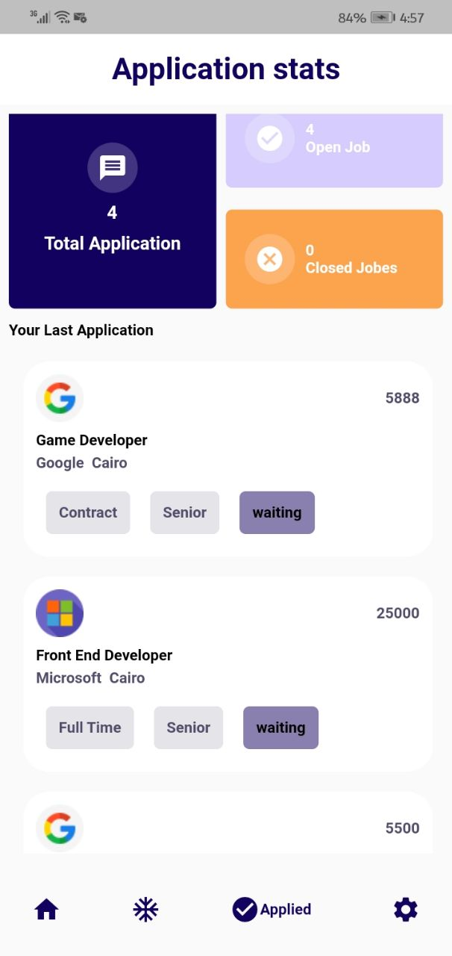
“Job Seeker
Scenario”
Application Statistics
Jobseeker can see all his Applications
That he have applied to them (open & closed).
Also can see every status to every application
That he have submitted before :
Waiting , Accepted , Rejected

Slide 15

“Job Seeker
Scenario”
If jobseeker apply for a job for a company
and a company accepted,rejected the
application Then the user will get
a Notification with the new status
(accepted , rejected)

Slide 16
Company Scenario 03

Slide 17
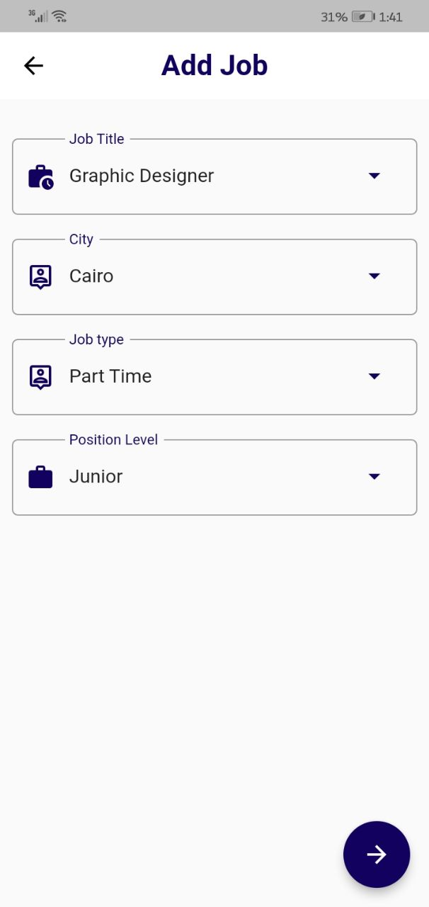
“Company Scenario”
Create a job :
Enter job_title , job_tybe ,salary, skills,
City , job_requirements ,
Job_description , position_level,
Start_date,expire_date

Slide 18
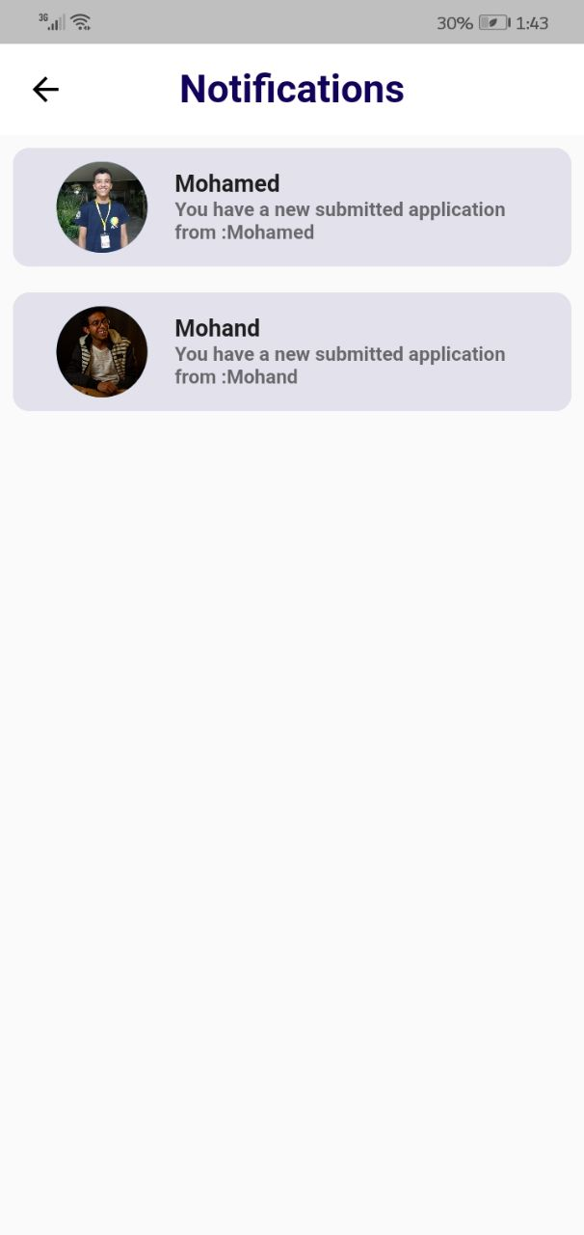
“Company Scenario”
Notifications :
When a jobseeker apply to job a company get
Notifications that a jobseeker apply to a job that
A company have created before

Slide 19
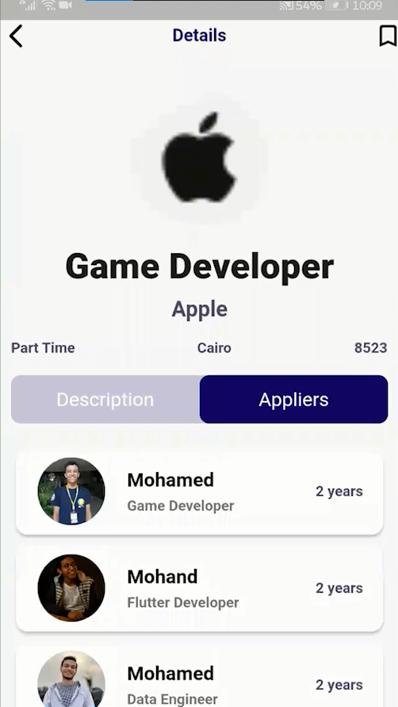
“Company Scenario”
Applied jobseekers :
See all applied jobseekers and compare with them to choose best candidate and accept him

Slide 20


“Company Scenario”
A company can contact
To jobseeker with email to set
Time to complete work flow of
Hiring process
Company create feedback
And admin receive it

Slide 21
Related Work & S W O T 04

Slide 22


Related Work
does not have a mobile Application.
Companies will pay money when they publish a post

Slide 23
SWOT
Weakness
Strengths
All of our features
*we dont have chat and chat bot
* Not used a Machine learning model to confirm jobseekers data with National Id
Opportunities
Threats
Expand the number of customers to find a job
Having a lot of competitors

Slide 24
Future Work 04

Slide 25
Future Work
Video resumes : can be used to provide a more personalized and engaging way for job seekers to showcase their skills and experience .
We will add a chat and chat bot to answer the most commen questions and contact easily
with company.
We plan to launch the beta version for close people and friends to test the project at the advanced operating level to fix any errors.
Add machine learning model to confirm jobseekers data with National Id .

Slide 26
Tools & Technology 06

Slide 27




Tools & Technology
01
03
03
02
04

Slide 28





Tools & Technology
05
09
07
06
08

Slide 29

QUESTIONS?
Thanks

